Slide 1

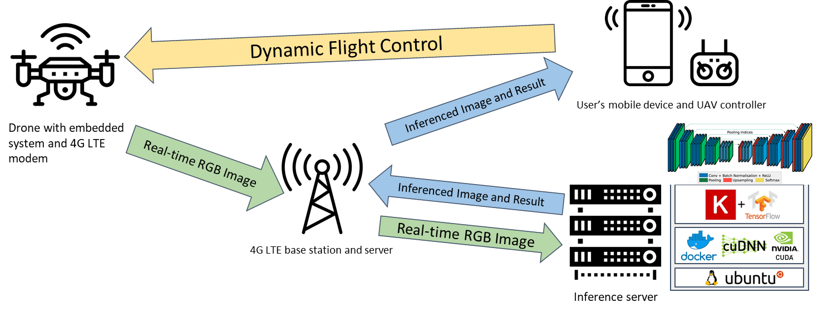

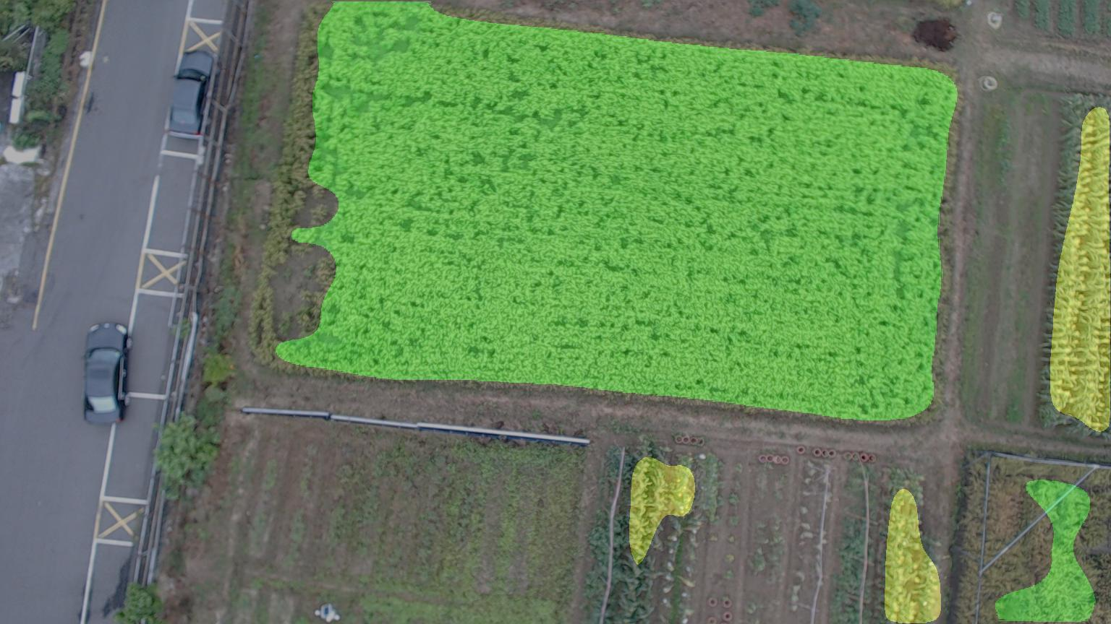
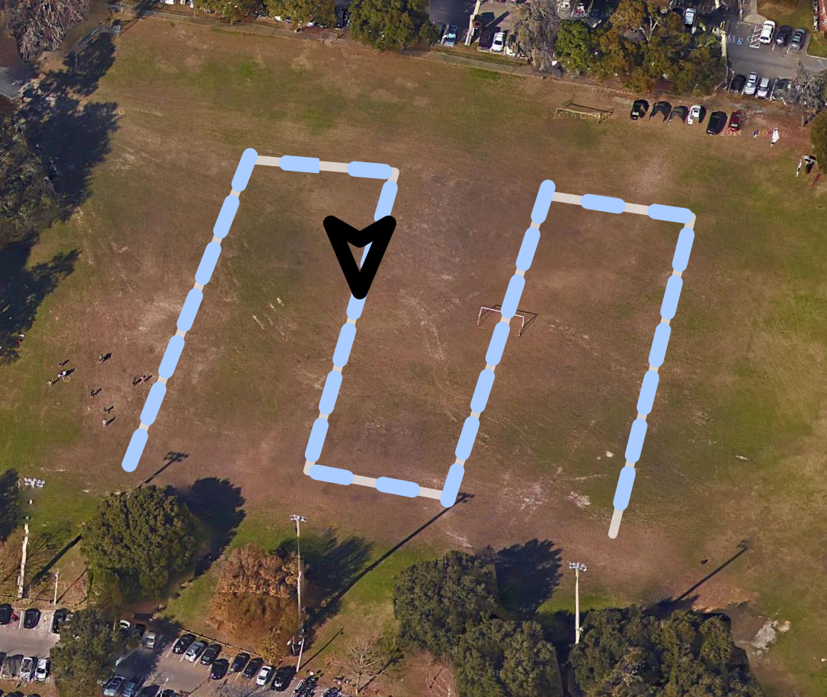


SAGE2 Component for AUAV Applications for Smart Agriculture
Michael Elliott¹, Parth Patel¹, Ming-Der Yang², Hui Ping Tsai², Cloud Tseng², Yu-Chun Hsu², and Christopher Stewart³, José A. B. Fortes¹
1 University of Florida, USA; 2 National Chung Hsing University, Taiwan; 3 Ohio State University, USA
Extends the "AUAV Applications for Smart Agriculture” project by the IDCSA lab at NCHU
Replaces the mobile device component with a remotely-accessible alternative built on SAGE2
The application visualizes raw and inferenced image streams sent from an aerial drone.
The application also includes a GUI for plotting a flight path and displays logistics and controls for the drone itself.
Use Case:
An operator could use the SAGE2 application to monitor multiple smart agricultural UAVs.

